Slide 1

Unit III
Session 22 to 24
Contents
Data formatting
Differential Pulse Code Modulation(DPCM)
Delta Modulation

Slide 2
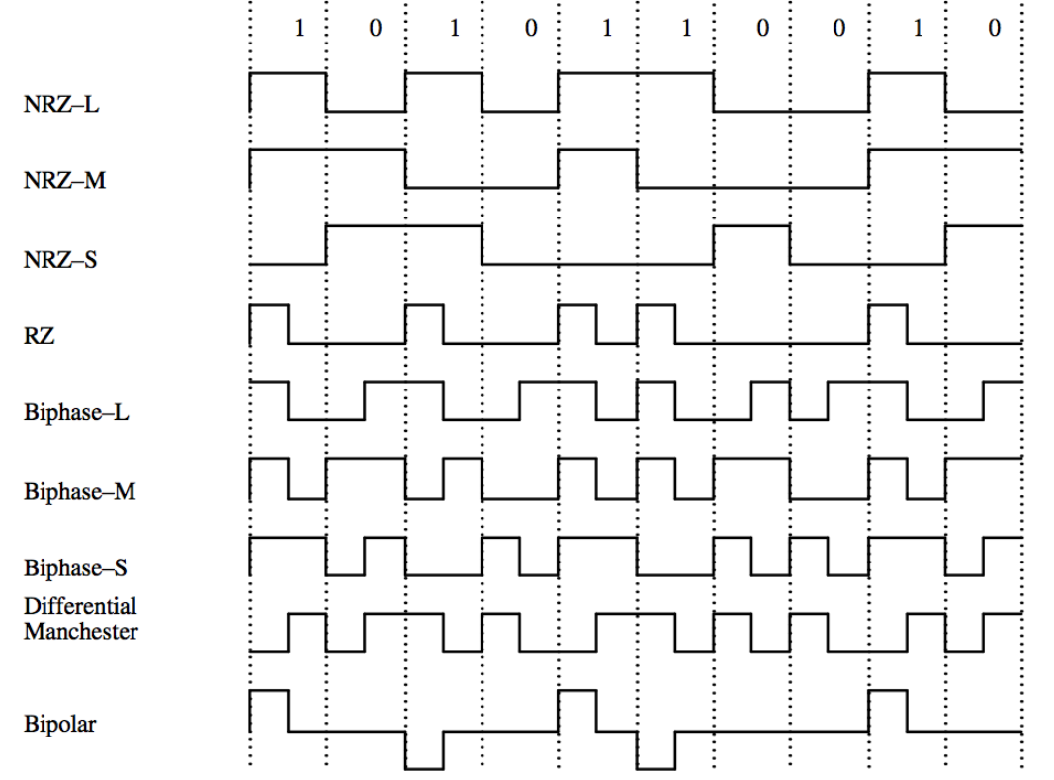
Data formatting

Slide 3
Line codes can be used for the electrical representation of a binary data stream.
The different types of line codes are
1. NRZ – Non-return to Zero
2. RZ -Return to Zero
3. Phase encoded group
1.NRZ
Most commonly used PCM waveform . It can be partitioned into the following subgroups.
a. NRZ-L (L for level)
b. NRZ-M (M for mark)
c. NRZ-S (S for space)
a. NRZ-L
If symbol ‘1’ is transmitted, x(t)=+V for 0≤t ≤ T
If symbol ‘0’ is transmitted, x(t)=-V for 0≤t ≤ T
b. NRZ-M
If symbol ‘1’ is transmitted , one or mark is represented by a change in level.
If symbol ‘0’ is transmitted , zero or space is represented by no change in level.

Slide 4
c. NRZ-S
It is the complement of NRZ-M
In NRZ-S, one is represented by no change in level
and zero is represented by a change in level.
2.Return to Zero (RZ)
The RZ waveform consists of
a. Unipolar RZ
b. Bipolar RZ
c. RZ-AMI
These codes find applications in base data transmission and in magnetic recording.
a.Unipolar RZ
If symbol ‘1’ is transmitted, x(t)=+V for 0≤t ≤ T/2
= 0 for T/2≤t ≤ T
If symbol ‘0’ is transmitted, x(t)=0 for 0≤t ≤ T

Slide 5
b.Bipolar RZ
If symbol ‘1’ is transmitted, x(t)=+V for 0≤t ≤ T/2
= 0 for T/2≤t ≤ T
If symbol ‘0’ is transmitted, x(t)=-V for 0≤t ≤ T/2
= 0 for T/2≤t ≤ T
c.RZ-AMI
AMI – Alternate Mark Inversion.
The ones are represented by equal amplitude alternating pulses
The zeros are represented by the absence of pulses.
3.Phase encoded group
It consists of
a. Bi-ø-L (Bi phase Level /Manchester coding)
b. Bi-ø-M (Bi phase Mark)
c. Bi-ø-S (Bi phase Space)

Slide 6
a.Bi-ø-L
If symbol ‘1’ is to be transmitted (positive half interval pulse is followed by a negative half interval pulse)
x(t)= +V for 0≤t ≤ T/2
= -V for T/2≤t ≤ T
If symbol ‘0’ is to be transmitted (negative half interval pulse is followed by a positive half interval pulse)
x(t)= -V for 0≤t ≤ T/2
= +V for T/2≤t ≤ T
b.Bi-ø-M
A transition occurs at the beginning of every bit interval.
Symbol ‘1’ is represented by a second transition one half bit interval later.
Symbol ‘0’ is represented by no second transition but there is a transition in the beginning of the bit interval.

Slide 7
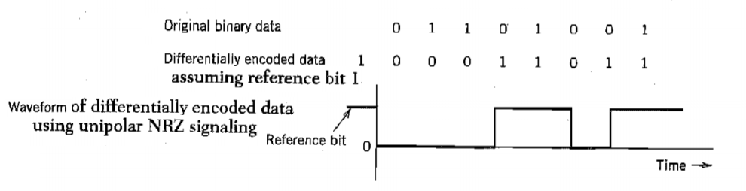
c.Bi-ø-S
A transition occurs at the beginning of every bit interval.
Symbol ‘1’ is represented by no second transition.
Symbol ‘0’ is represented by a second transition one half bit interval later.
Differential encoding
It is used to encode information in terms of signal transition.
A transition is used to designate symbol ‘o’ while no transition is used to designate symbol ‘1’.

Slide 8
The original binary information is recovered by comparing the polarity of adjacent binary symbols to establish whether or not a transition has occurred.
It requires the use of reference bit before initiating the encoding process.
Here , symbol ‘1’ is used as the reference bit.

Slide 9
Differential Pulse Code Modulation (DPCM)
DPCM is a technique in which the difference between the samples, rather than the sample values themselves, is encoded in binary.
The reason for employing DPCM is that speech samples do not change drastically from sample to sample and therefore the difference values can be encoded using fewer bits.

Slide 10
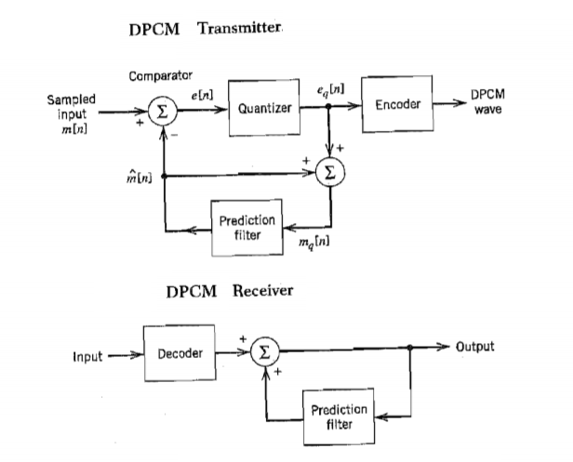

Slide 11



Suppose a baseband signal m(t) is sampled at the rate fs=1/Ts to produce the sequence {m(nT)} where samples are Ts seconds apart.
The input signal to the quantizer is defined as,
------------- (1)
where m[n]- input sample (unquantized)
- predicted sample
The predicted value is produced by using a linear prediction filter whose input is quantized version of the input sample m[n].
The difference signal is the prediction error e[nT].It is the amount by which the prediction filter fails to predict the input exactly.
----------- (2)
where q[n] – quantization error

Slide 12







The quantizer output is added to the predicted value to produce the prediction filter output.
-------------- (3)
substituting equation (2) into (3) , we get
The sum of is equal to input sample m[n]. Therefore we may simplify the above equation as
- represents quantized version of the input sample m[n]. ie, irrespective of the properties of the prediction filter the quantized

Slide 13
sample at the prediction filter output differs from the original sample m[n] by the quantizer error q[n].
The receiver consists of a decoder to reconstruct the quantized error signal.
The quantized version of original input is reconstructed from the decoder output using the same prediction filter used in transmitter.
In the absence of channel noise, the encoded signal at the receiver input is identical to the encoded signal at the transmitter output.
Accordingly the corresponding receiver output is equal to , which differs from the original input m[n] only by q[n].
The feedback path added to the quantizer in the transmitter results in the prediction filter in the transmitter and receiver operate in the same sequence of samples in a noise-free environment .

Slide 14
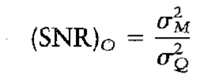
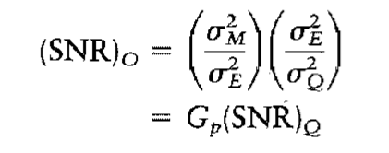
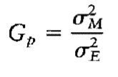
Processing Gain
The output signal to noise ratio of the DPCM signal is given by,
----- (4)
We may rewrite the equation (4) as the product of two factor

Slide 15

Delta Modulation (DM)
The delta modulation is a special case of DPCM.
DM is 1-bit version of DPCM.
In DM, an incoming message signal is oversampled to increase the correlation between adjacent samples of the signal.
It provides the staircase approximation to the oversampled version of the message signal.
The difference between the input and the approximation is quantized into only two levels , corresponding to positive and negative differences.
If the approximation falls below the signal at any sampling epoch, it is increased by
If the approximation lies above the signal ,it is decreased by

Slide 16
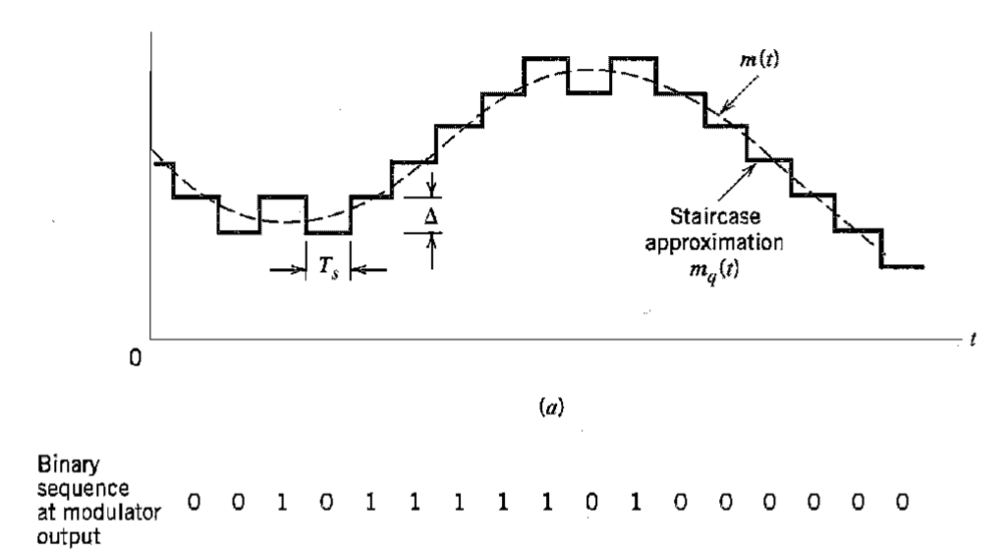
If there is no rapid change from sample to sample, then the stair-case approximation remains within of the input signal.
The staircase approximation mq(t) follows variations in the input signal m(t).

Slide 17
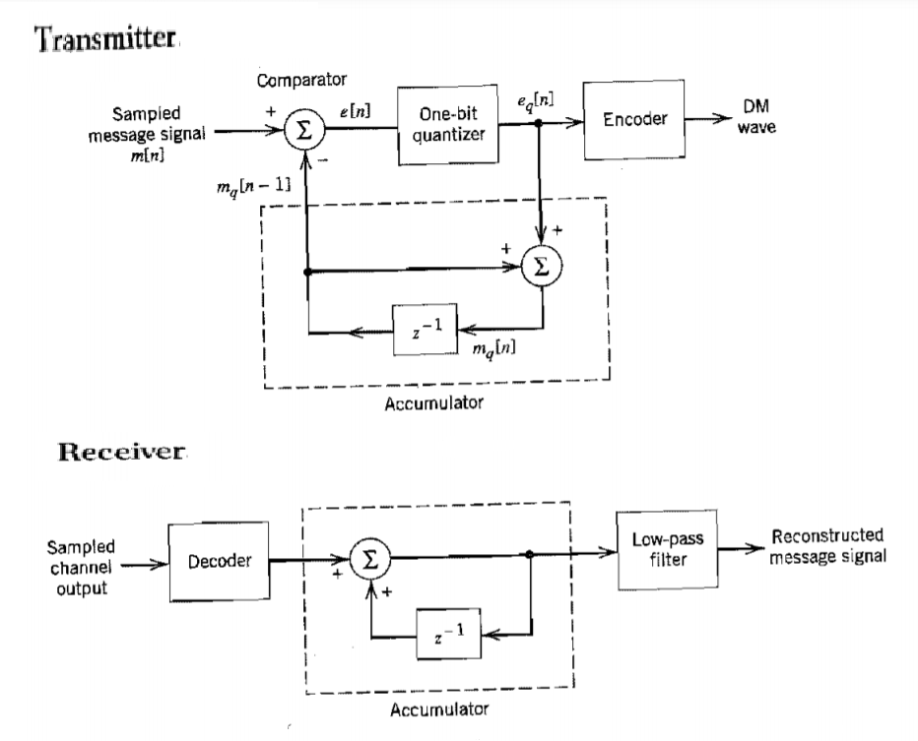

Slide 18

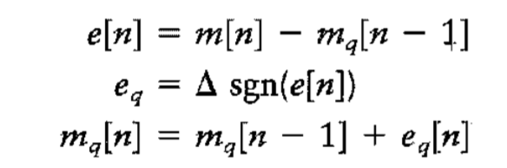

Let m(t) – input message signal ,mq(t) – its staircase approximation
m[n] –sequence of samples
m[nTs]- sample of m[t] taken at time t=nTs , where Ts is sampling period.
we have,
where
e[n] – error signal representing the difference between the present sample m[n] of the input signal and the latest approximation mq[n-1]
– quantized version of e(n)
sgn(.) –signum function
The quantizer output is coded to produce the DM signal.

Slide 19
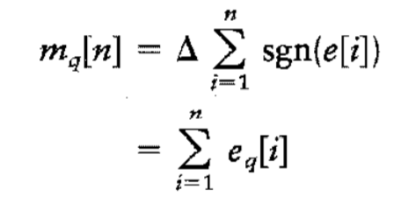
The rate of information transmission is equal to the sampling rate fs=1/Ts.
The delta modulated wave is generated by applying the sampled version of the incoming message signal to a modulator that involves a comparator , quantizer and accumulator.
z⁻¹ is unit delay.
The comparator computes the difference between its two inputs . The quantizer consists of hard limiter with an input-output relation that is scaled version of the signum function . Then the quantizer output is applied to the accumulator, producing the result,

Slide 20
Thus, at the sampling instant nTs, the accumulator increments the approximation by a step in a positive or negative direction, depending on the sign of the error signal e[n].
If the input sample m[n] is greater than the most recent approximation mq[n] , a positive increment + is applied to the approximation.
If the input sample is smaller, a negative increment - is applied to the approximation.
In the receiver, the staircase approximation mq(t) is reconstructed by passing the sequence of positive and negative pulses, produced at the
decoder output, through an accumulator. The quantization noise in staircase waveform mq(t) is rejected by passing it through a LPF.

Slide 21
The rate of information transmission is equal to the sampling rate fs=1/Ts.
The delta modulated wave is generated by applying the sampled version of the incoming message signal to a modulator that involves a comparator , quantizer and accumulator.
z⁻¹ is unit delay.
The comparator computes the difference between its two inputs . The quantizer consists of hard limiter with an input-output relation that is scaled version of the signum function . Then the quantizer output is applied to the accumulator, producing the result,

Slide 22
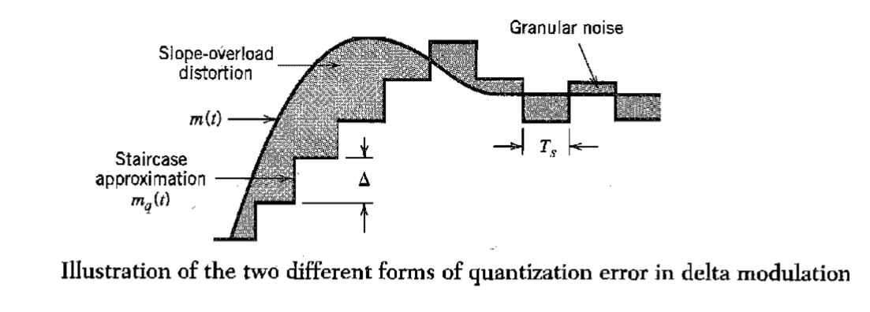
Noise in Delta modulation
Delta modulation subject to two types of quantization error.
a. Slope overload distortion b. Granular noise

Slide 23


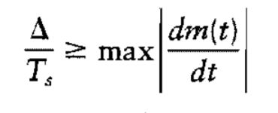
The quantization error by q[n] is
The input to the quantizer is ,
Thus except for the quantization error q[n-1], the quantizer input is a first backward difference of the input signal.
If we consider the maximum slope of the original input waveform m(t), it is clear that in order for the sequence of samples m[n] in a region of maximum slope of m(t),
we require that the condition be satisfied.
Slope-overload distortion : It occurs when the step size is too small for the staircase approximation mq(t) to follow a steep segment of the input waveform m(t), with the result that mq(t) falls behind m(t). This condition is called slope overload and the resulting quantization error is called slope-overload distortion(noise).

Slide 24
Since the maximum slope of the staircase approximation mq(t) is fixed by the step size , increases and decreases in mq(t) tend to occur along the straight lines. For this reason, a delta modulator using a fixed step size is often referred to as a linear delta modulator.
Granular noise: It occurs when the step size is too large relative to the slope characteristics of the input waveform m(t), thereby causing the staircase approximation mq(t) to hunt around a relatively flat segment of the input waveform . It is analogous to quantization noise in a PCM system.

